Slide 1
Intro To JS & D3
find all code at
https://github.com/explorablesforsfi/js-d3-tutorial
@BenFMaier at SFI

Slide 2




How to make something usable For The Web
Text
Arrange things
style things
Connect them to code
code

Slide 3
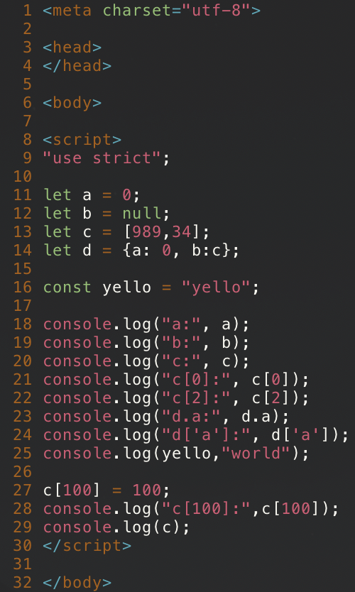
Variables and Printing
HTML basic skeleton
Starting a JS segment
"use strict" is better for debugging (gives errors when variables are misused)
"null" is like "nullptr" in C++ or "None" in Python
"let" defines a variable within the current scope (use "var" for global variable)
console.log() is like an interactive print statement
You can add things to an arbitrary position of an array

Slide 4
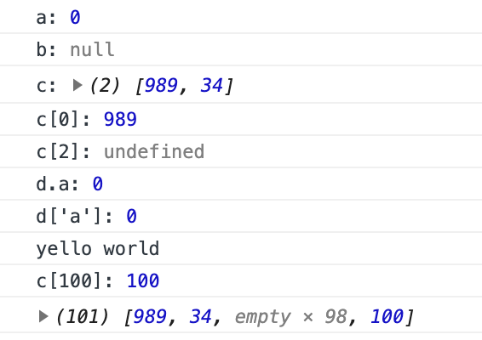
Variables and Printing
Output

Slide 5
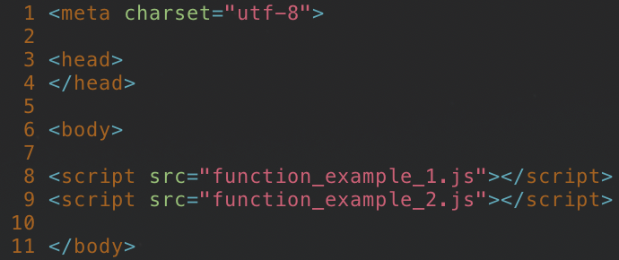
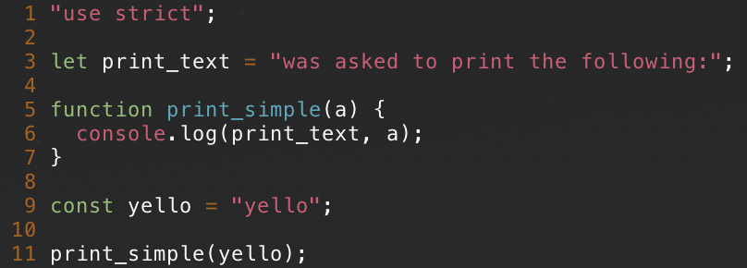
Functions
index.html
load external scripts
function_example_1.js
`print_text` will be available to all functions
define a function which puts stuff in the console
define a global constant
call the function

Slide 6
Functions
index.html
load external scripts
function_example_1.js
output

Slide 7
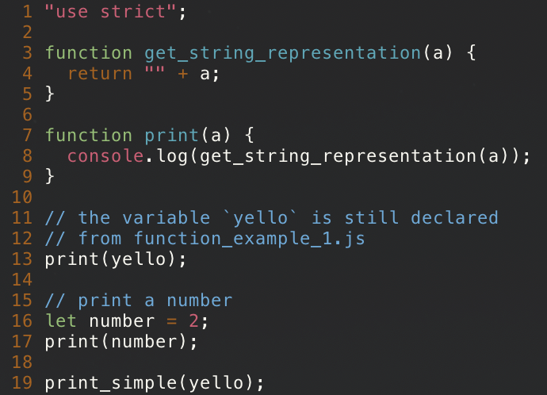
Functions
index.html
function_example_1.js
function_example_2.js
define a function which type-casts a variable to a `String` object
this function gets a String representation of a variable and prints it
This number is type-cast to a string and printed
This function is still available from `function_example_1.js`

Slide 8
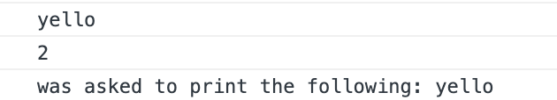
Functions
index.html
function_example_1.js
function_example_2.js
Output

Slide 9
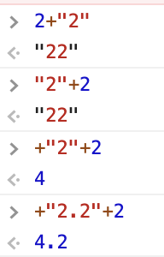
Typecasting
number + string -> string
string + number -> string
+ string -> number + string + number -> number

Slide 10
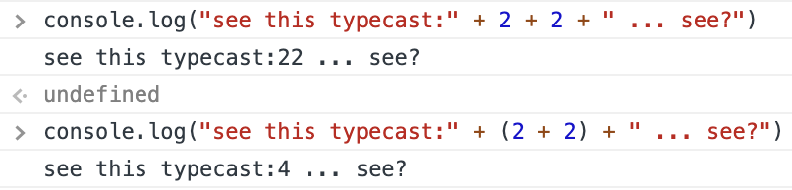
Typecasting
number + string -> string
string + number -> string
+ string -> number + string + number -> number

Slide 11
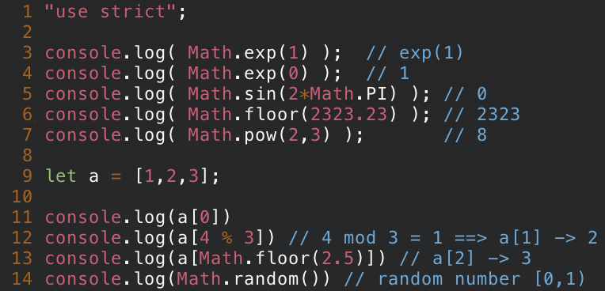
MATH

Slide 12
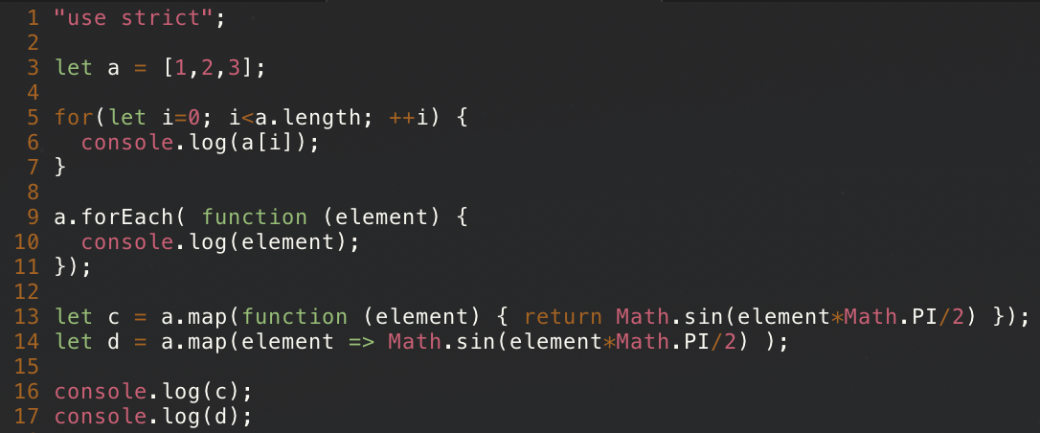
For-Loops and maps
print each element
for each element in the array, call a function which prints it
for each element of the array, call a function, which manipulates it and returns the manipulation, then return an array of the whole manipulated array

Slide 13
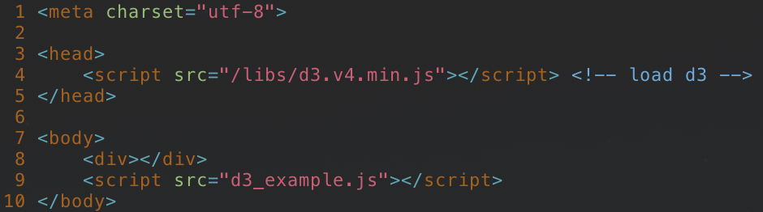
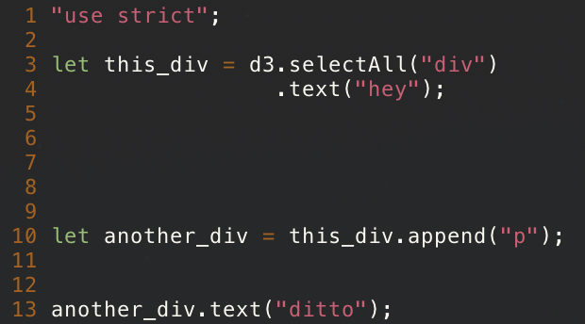
Select DOM objects with d3
index.html
d3_example.js
selectAll elements called "div"
make "<div></div>" to "<div>hey</div>"
"selectAll" is a function which does something and then returns the selection. "text" is a function which puts the text in the selection and then, again, returns the selection.
the selection can then further be manipulated

Slide 14
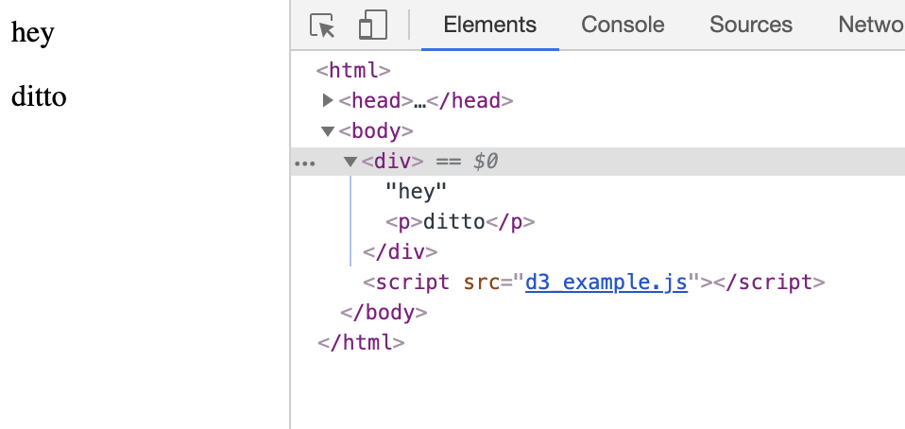
Select DOM objects with d3
index.html
d3_example.js
output

Slide 15
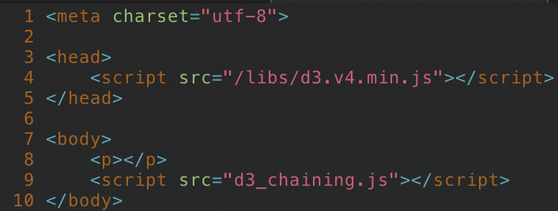
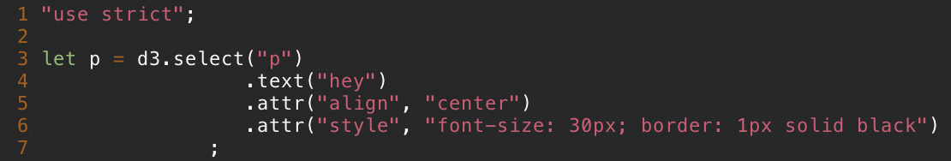
Chaining in d3
index.html
d3_chaining.js
select first <p> and return selection
put text in
give new attribute
Style with CSS

Slide 16
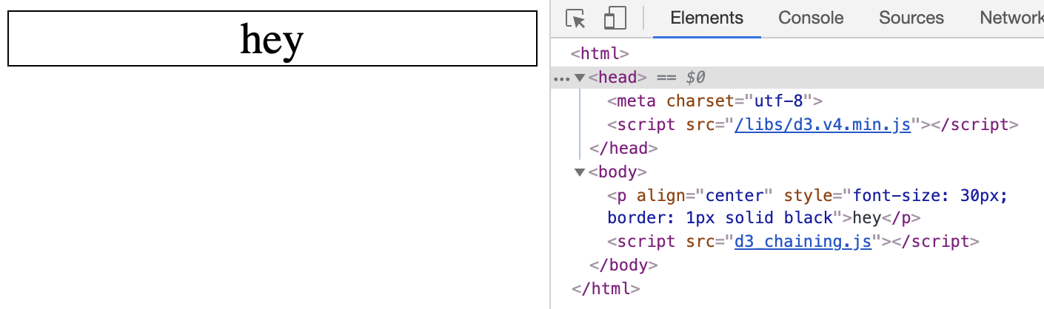
Chaining in d3
index.html
d3_chaining.js
output

Slide 17
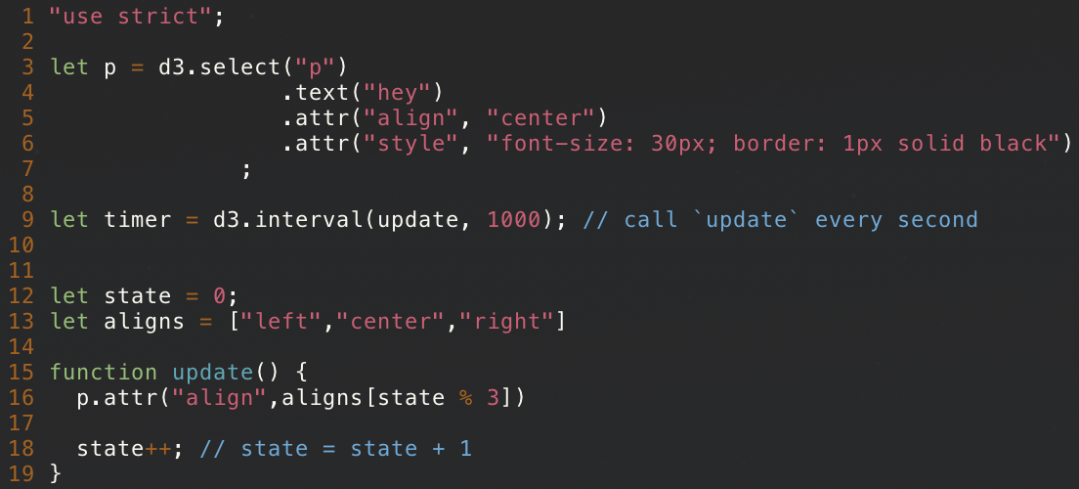
Timers in d3
d3_timers.js

Slide 18
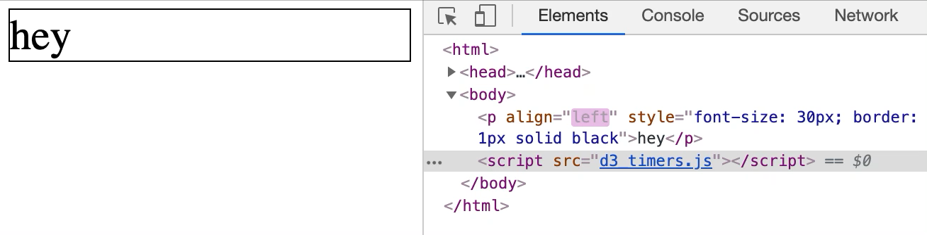
Timers in d3
d3_timers.js

Slide 19
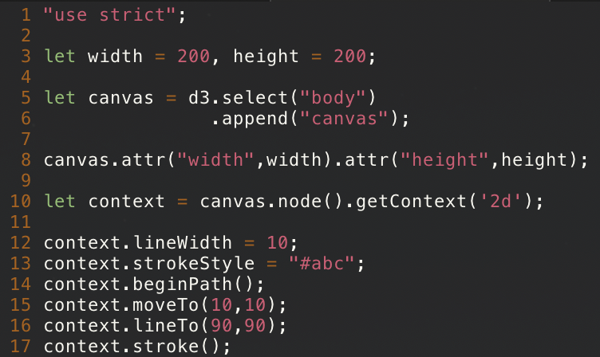

Drawing on Canvas
append a `canvas` object to the body
context is for drawing
draw a 10px wide line from (10,10) to (90,90)
output

Slide 20
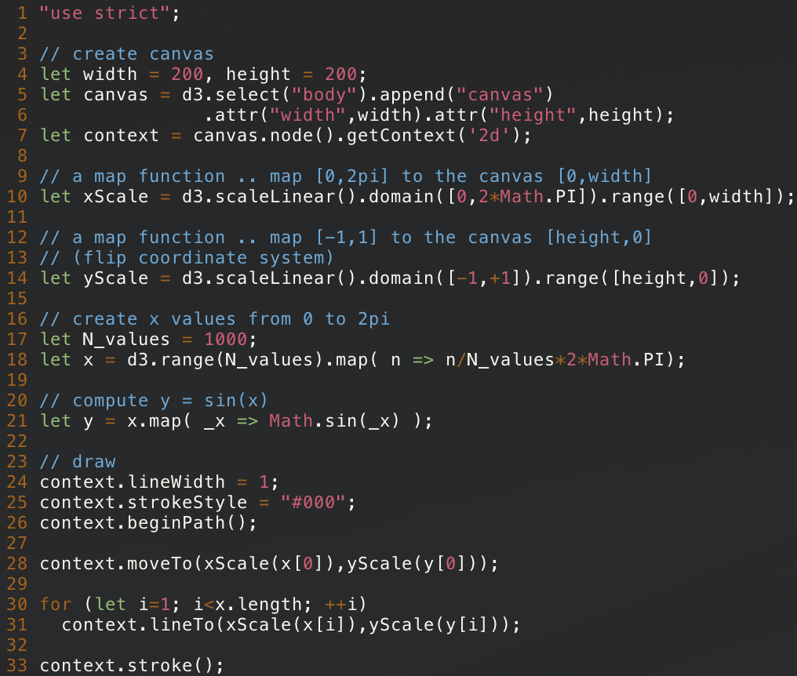
A plot on Canvas

Slide 21
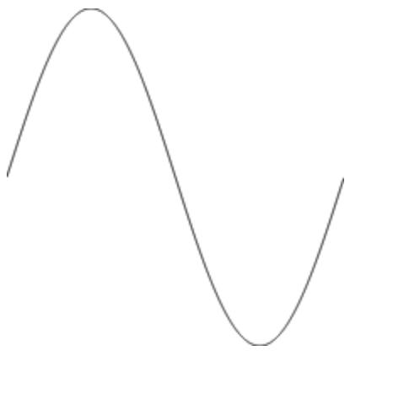
A plot on Canvas
output

Slide 22
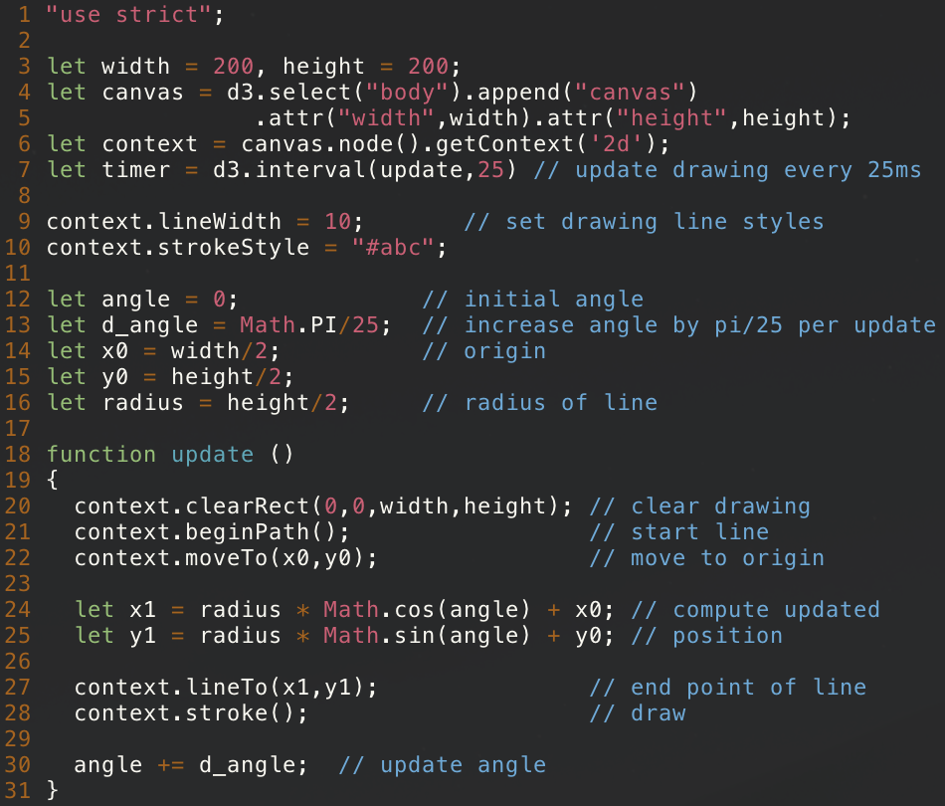
Animation on Canvas

Slide 23
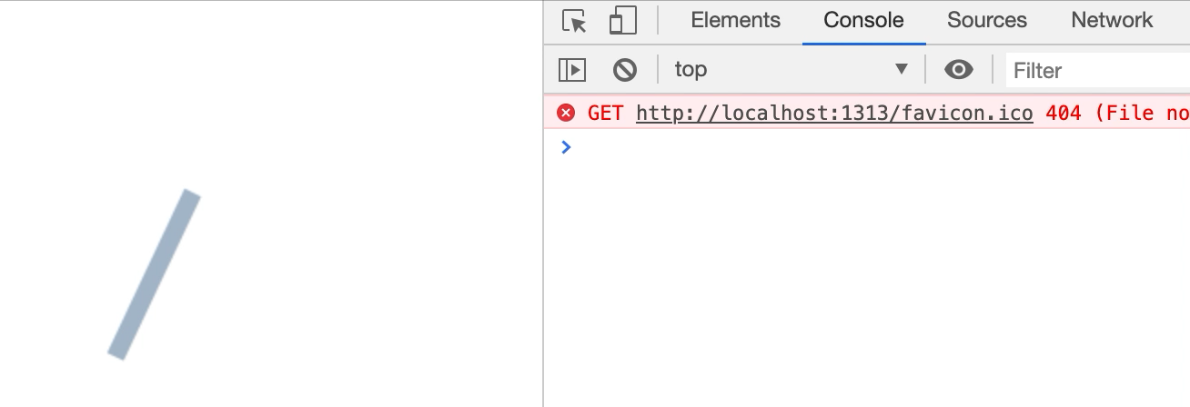
Animation on Canvas

Slide 24
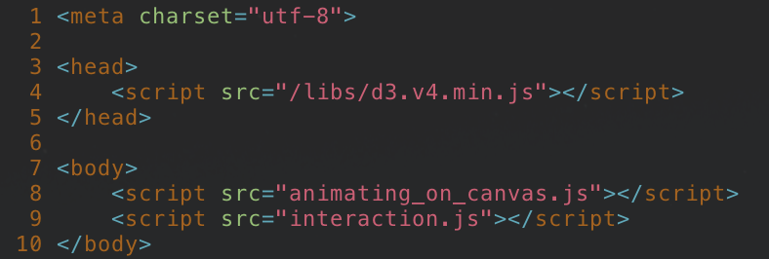
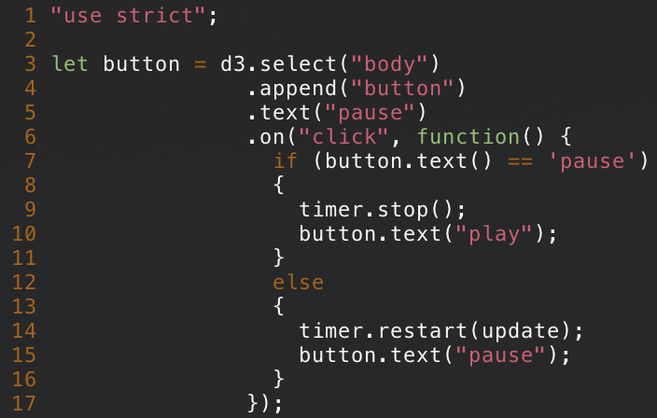
InteractioN
index.html
same as in last slide
interaction.js
add a button to the body which says "pause"
when clicked, run the following function
* button.text() is a context-sensitive function. * when called without arguments it returns the value of the HTML-property * when called with argument, it sets the HTML-property and returns the selection.

Slide 25
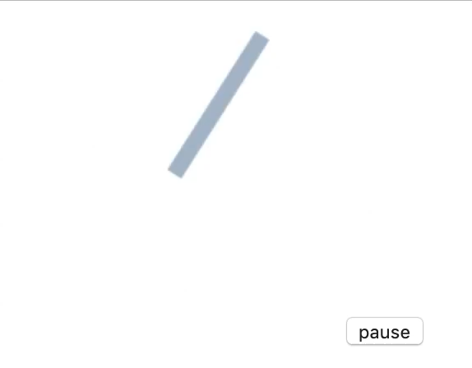
InteractioN
index.html
interaction.js
output

Slide 26
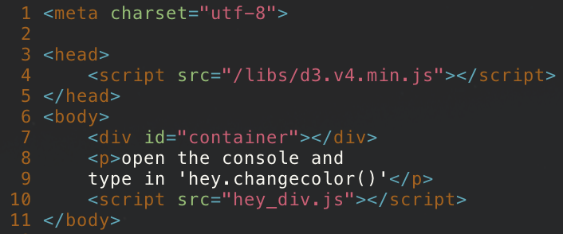
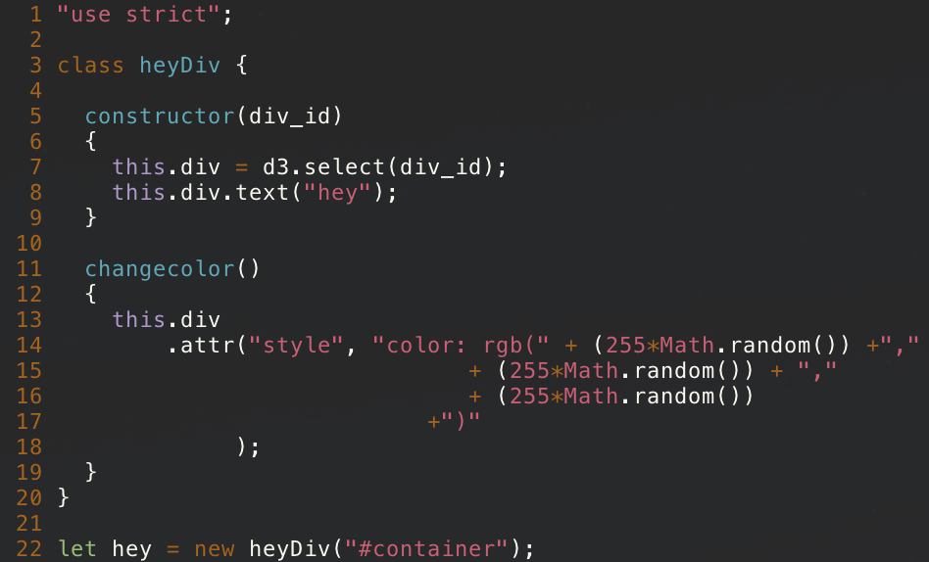
Classes
index.html
we want to create the container DOM before we call the script
hey_div.js
define class
constructor is invoked upon creation
construct a "div" and let it be a property of this object (this-keyword)
one method of this class will be that upon request it will change the font color
create the new object and save it to a variable

Slide 27
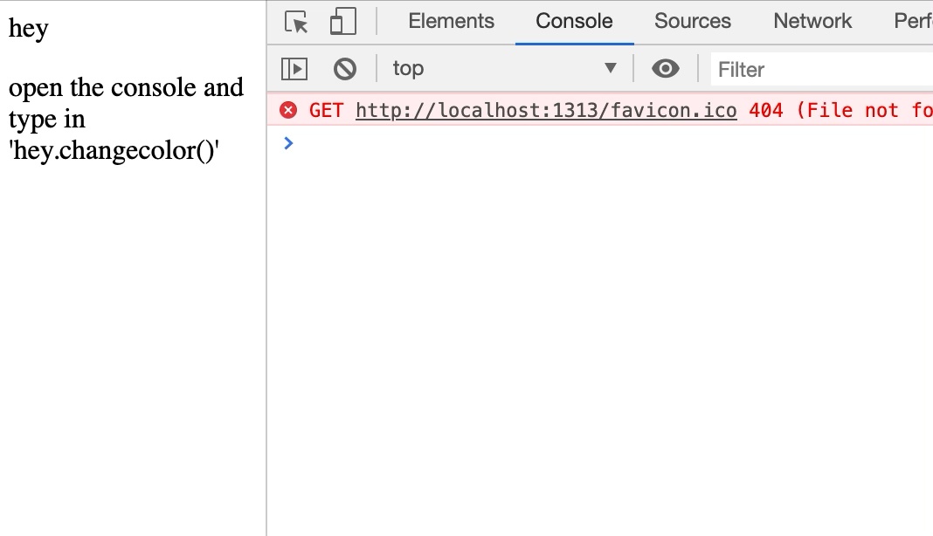
Classes
index.html
hey_div.js
output

Slide 28
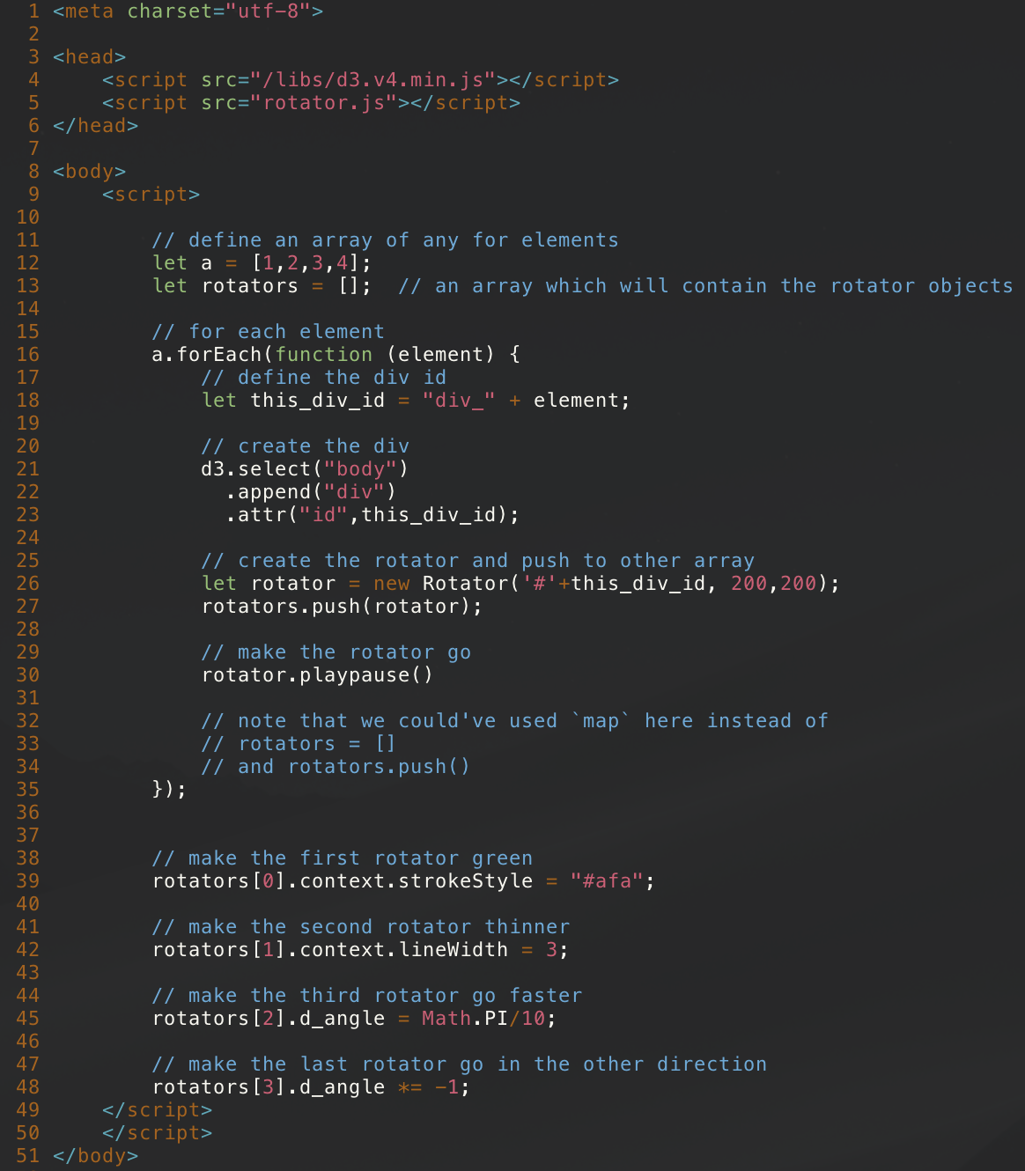
A Rather complicated class
idea: generalize the button-rotator concept and allow for individual manipulation of these objects

Slide 29
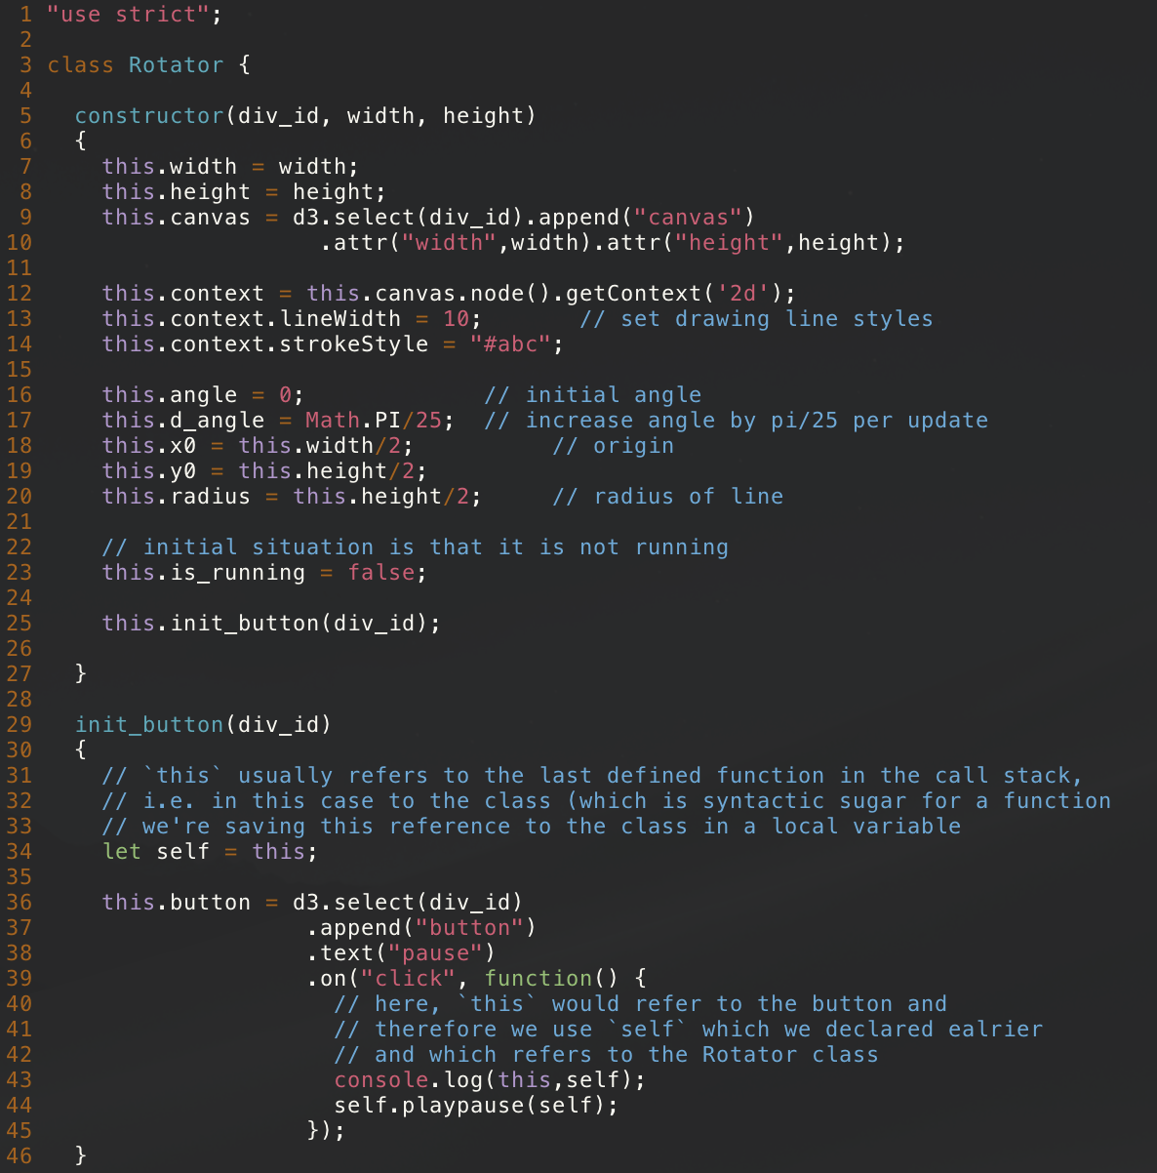
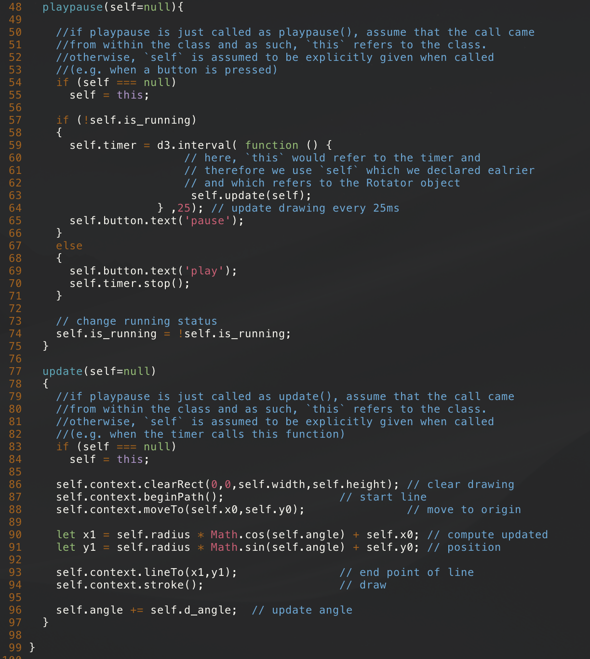
A Rather complicated class

Slide 30
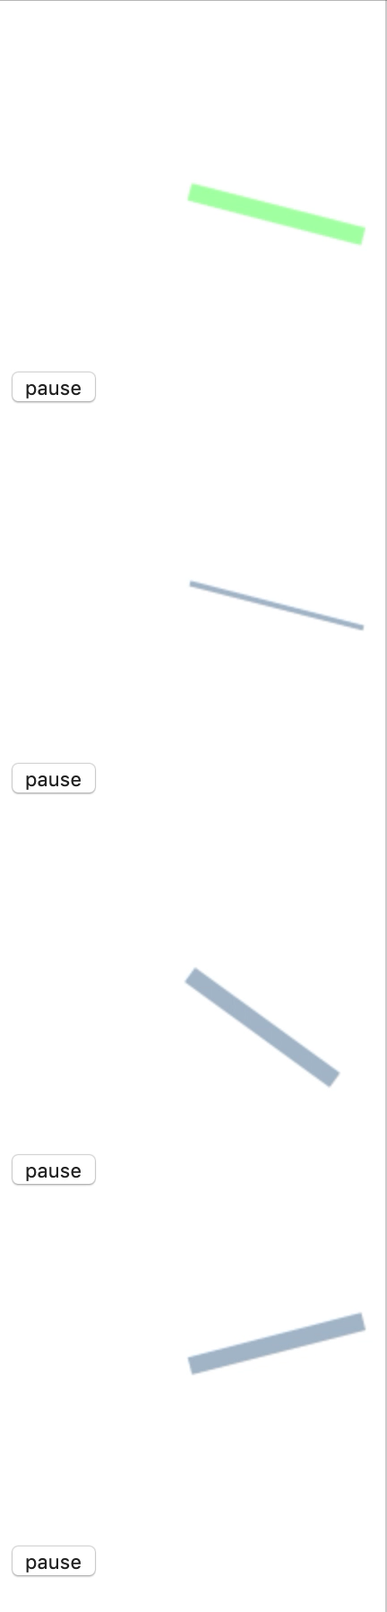
A Rather complicated class

